Slide 1
Achieving performance in C#
September 9, 2016

Slide 2
Agenda
Introduction
Memory Management
Flow and Control Structures
Data Structures
Function Calls

Slide 3
Memory Management

Slide 4
Assemblies
Prefer single large assembly rather than multiple small assemblies
Overhead
The cost of loading metadata for smaller assemblies
Touching various memory pages in pre-compiled images in CLR in order to load the assembly (ngen)
JIT compile time
Security checks
Sometimes you can not avoid splitting assemblies. For e.g. for versioning and deployment reasons. If you need to ship types separately, you may need to separate assemblies

Slide 5
Memory
Allocation:
Is superfast!!
Free:
Is super slow!!
You want to avoid freeing memory. The easiest way to do so is not to allocate in the first place

Slide 6
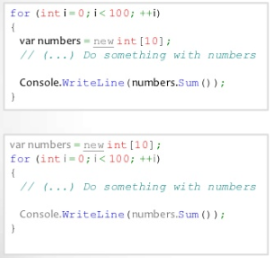
Reuse Memory
Do not use a new in for loop unless you really need to

Slide 7
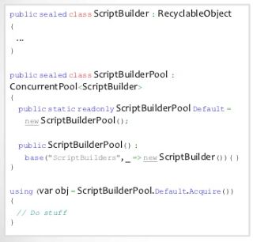
Object Pools
Object pooling is something that tries to keep a pool of objects in memory to be re-used later and hence it will reduce the load of object creation to a great extent
Object pool is nothing but a container of objects that are ready to use

Slide 8
Class Design
Do not make classes Thread safe by default
Consider using Sealed keyword
Consider the trade offs of Virtual members
Consider using overloaded methods
Consider overriding the Equals method for value types
Know the cost of accessing a property
Consider private vs. public member varialbes
Limit the use of volatile fields

Slide 9
Class Vs. Struct
Class
A reference type
Lives in the heap
Slower
Struct
A value type
Lives in the stack
Faster
But never use structs that are bigger than 16 bytes. Use them wisely

Slide 10
Threads
Threads are shared resource
Do not create thread on a per-request basis because this can severely impact scalability. Creating new threads is also a fairly expensive operation that should be minimized. Treat threads as a shared resource and use the optimized .Net thread pool
Locking is slow, avoid locking large portions of code
Minimize Thread creation
Use the Thread Pool when you need threads
Use a timer to schedule periodic tasks
Never use Thread.Abort
Never use Thread.Suspend or Thread.Resume

Slide 11
Flow and Control

Slide 12
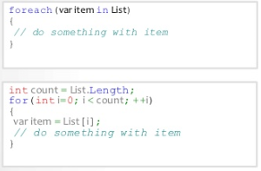
For Vs.For..Each
For and For..each loops are different
For..each is less performent than For lop
For..each creates garbage
Always prefer For loop for critical code
Any idea why?

Slide 13
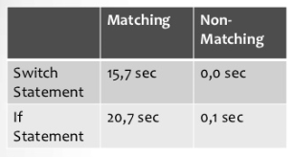
Switch Vs if
A Switch statement compiles to a different set of instructions and optimized for fast state-machines
Because each case within a switch statement does not rely on earlier cases, the compiler is able to re-order the testing in such a way as to provide the fastest execution

Slide 14
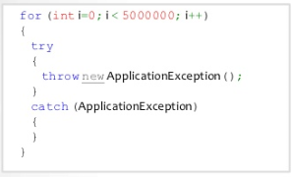
Exceptions
When an exception is thrown your application dies a little bit
Never throw exception in prder to control the flow of an application
However do not use error codes because of concerns that exceptions might affect performance negatively
Consider using TryParse() pattern

Slide 15
Data Strucctures

Slide 16
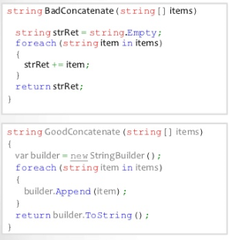
Strings
C# Strings are immutable
Prefer String.Concat() to String.Format()
String Builder is the only way to create mutable strings, but still creates a gurbage

Slide 17
Collections
Use the right type of collection
Stop using List<T> for everything
Ask yourself
Do you need to sort your collection?
Do you need to search your collection?
Do you need to access each Element by Index?
Do you need a custom collection?

Slide 18
Collections
Use the right type of collection
Stop using List<T> for everything
Ask yourself
Do you need to sort your collection?
List<T> to bind read only sorted data
NameValue Collection for sorting strings
SortedList<K,V> presorts while constructing
Do you need to search your collection?
Use Dictionary<K,V>
Do you need to access each Element by Index?
Use List<T>, Dictionary<K,V>, SortedList<K,V>
Do you need a custom collection?

Slide 19
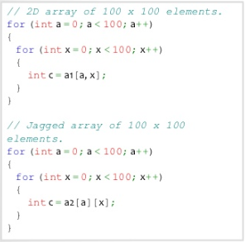
Arrays
Multidimentional arrays [,] are slow
Prefer jagged arrays [][]
Arrays have a static size. The size of array remains fix after initial allocation

Slide 20
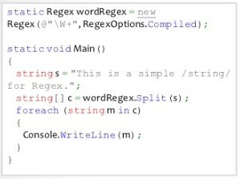
RegEx
A Regular Expression is essentially a state machine
Always use RegExOptions.Compiled if you plan to reuse a regular expression
RegEx.Options.Compiled takes 10x longer to starup,but yields 30% better runtime

Slide 21
Functions

Slide 22
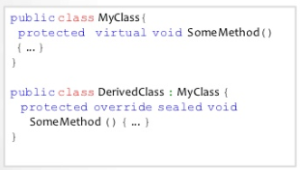
Inline
You want the compiler to inline methods
Mark them as sealed
This code ends the chain of virtual overrides makes a DerivedClass.SomeMethod a candidate for the inlining

Slide 23
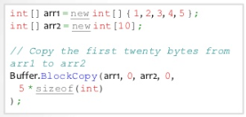
Copying Buffers
Never copy buffers with a loop, prefer Buffer.BlockCopy() or Array.Copy()

Slide 24
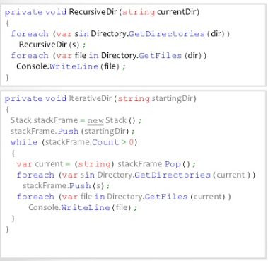
Recursion
Avoid recursion
Most of the recursion can be converted to tail-recursion
A tail-recursion is a simple loop

Slide 25
More Tips
LINQ is slow never use it if you need performance
Never use reflection if you need performance
Keep IO buffer size between 4KB and 8KB
Always use Asynchronus IO (Uses IOCP on windows)
ASP.NET: cache aggressively
ASP.NET: use session state only if you need to
ASP.NET: remove unnecessary Http modules
Reduce Boundary crossings (Unmanaged/Managed, Cross Process, Cross AppDomain)
Prefer Single Large assemblies
Never use GC.Collect() unless you know about what you are doing
Do not implement Finalize unless required

Slide 26

Thank You!
Prashant Kulkarni
Technical Lead
Mobile: +91 9890913122
Desk: +91 20 66046341
Prashant.kulkarni@xoriant.com
www.xoriant.com
India
Mumbai
4th Floor, Nomura
Powai , Mumbai 400 076
Pune
5th Floor, Amar Paradigm
Baner, Pune 411 045
Kolkata
2B, 12th Floor, Tower ‘C’
Rajarhat, Kolkata 700 156
US – Corporate Headquarters
1248 Reamwood Avenue,
Sunnyvale, CA 94089
Phone: (408) 743 4400
343 Thornall St 720
Edison, NJ 08837
Phone: (732) 395 6900
UK
20 Broadwick Street
Soho, London
W1F 8HT, UK
89 Worship Street
Shoreditch,
London EC2A 2BF, UK
Phone: (44) 2079 938 955
Bangalore
4th Floor, Kabra Excelsior,
80 Feet Main Road, Koramangala 1st Block,
Bengaluru (Bangalore) 560034
Gurgaon
A/373rd Floor, Sigma Center
Gurgaon, Haryana 122 011s

